Slide 1
An Exploratory Analysis: How Did Covid-19 Affect the U.S. Economy?
Tenacious D: Colin Brooks, Cole Valentyn, Doug Hooper, Brandy Bowden, Matthew Copello, Michael Goff, Tiffany Zhang, Cydney Goodwin-Hamel

Slide 2
Introduction:
Goal: To explore the effects of the Covid-19 pandemic on the American economy. The project was broken into topics to discuss at a high level:
Stock Market: The stock exchange
Colin & Tiffany
Unemployment Rates: The number of unemployed people as a percentage of the labor force (the sum of the employed and unemployed)
Cydney & Brandy
Federal Funds Rate: The lending rate that is determined when a bank lends money to another bank
Mike
Deficit Spending: Government spending in excess of tax revenue raised by borrowing & GDP (Gross Domestic Product) measures the total monetary value of all the finished goods and services produced
Cole & Doug
CPI: Consumer Price Index, a measure of the average change of inflation over time in the prices paid by urban consumers for a market basket of consumer goods and services
Matthew

Slide 3
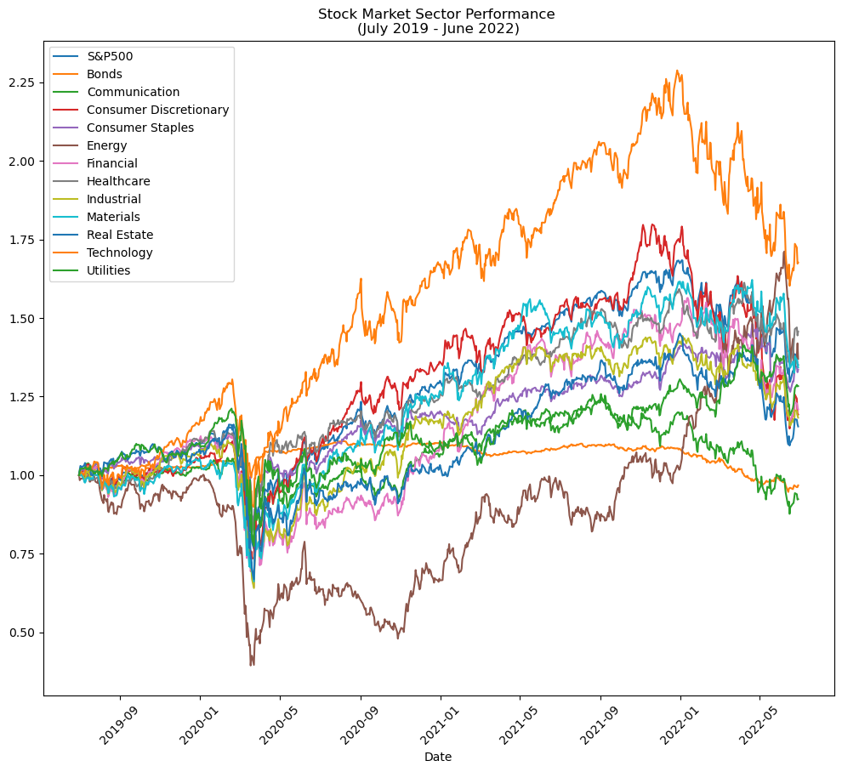
Stock Market Analysis
Stock Market Analysis Time Frame: 7/1/2019 - 6/30/2022
Original Hypothesis: Healthcare & Consumer Discretionary
Exploratory Analysis: Technology & Energy

Slide 4
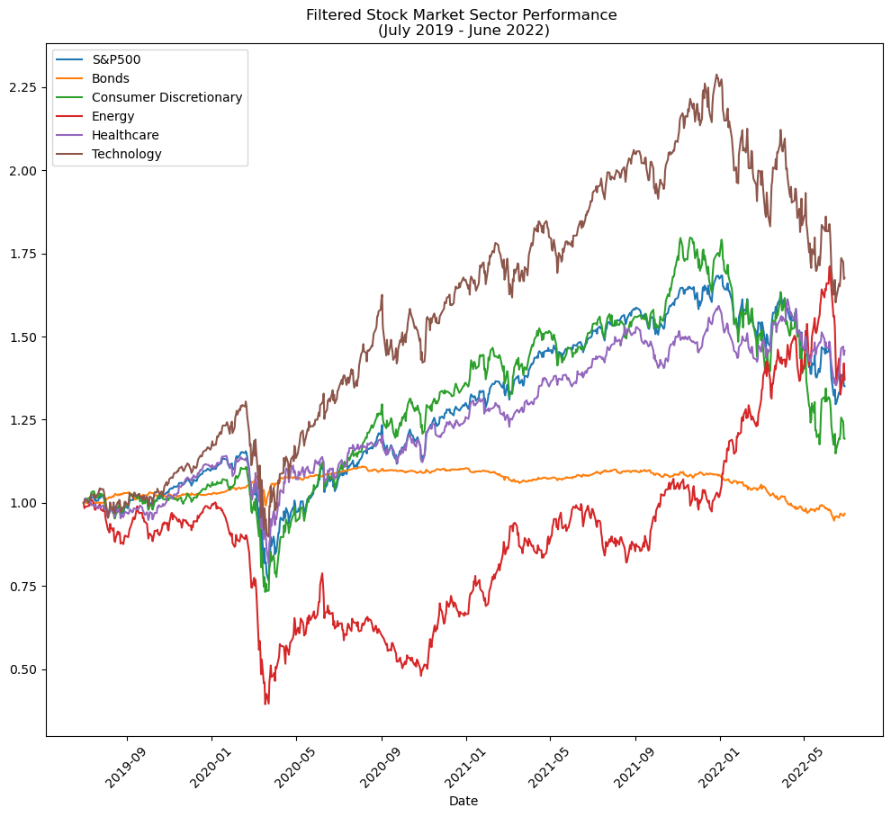
Filtered Stock Market Sector Performance

Slide 5
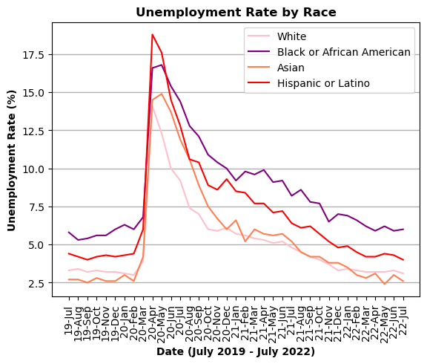
Unemployment Rates
Dataset: Bureau of Labor Statistics (BLS)
Unemployment Analysis Time Frame:
July 2019 – July 2022
Hypothesis: Mass loss of jobs during the pandemic
Exploratory Analysis: POC, and especially the LatinX race, were most affected at the height of the pandemic

Slide 6
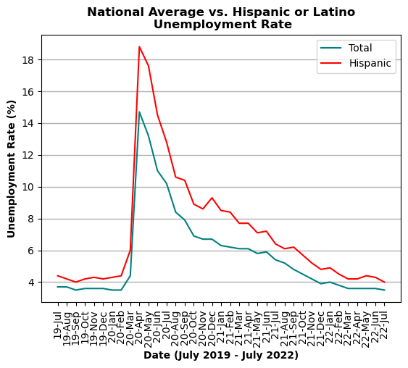
Total Unemployment vs. Hispanic or Latino

Slide 7
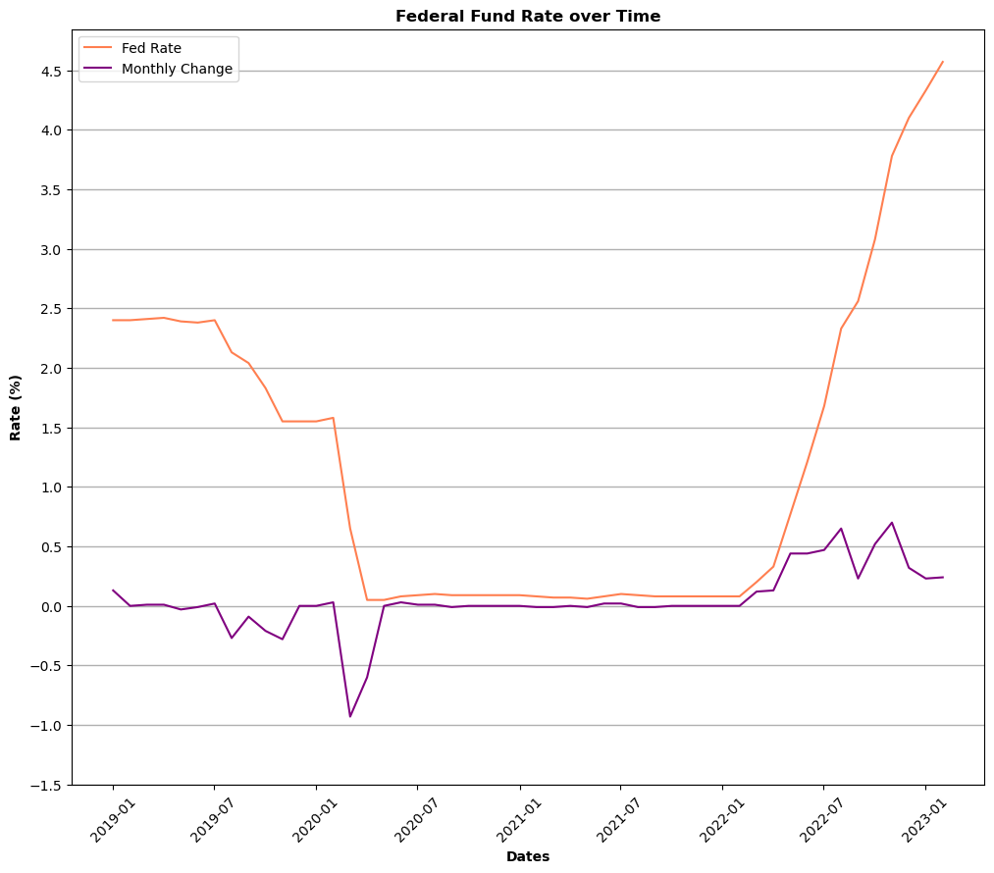
Federal Fund Rate
Fed Rate Analysis : 7/1/2019 - 6/30/2022
Original Hypothesis: Government Influence
Exploratory Analysis: Results of the Government Influence

Slide 8
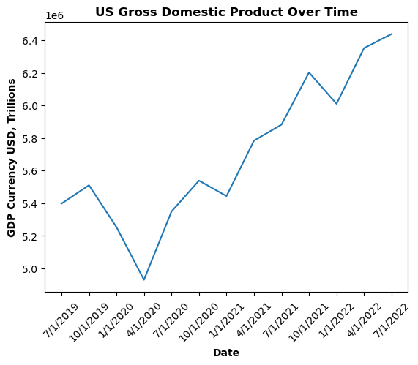
Gross Domestic Product (GDP)
GDP Value Analysis: 7/1/2019 - 6/30/2022
Original Hypothesis: GDP value would have been very low for a long period of time (~ almost a year)
Exploratory Analysis: GDP value dipped drastically but spiked back up to normal very quickly.

Slide 9
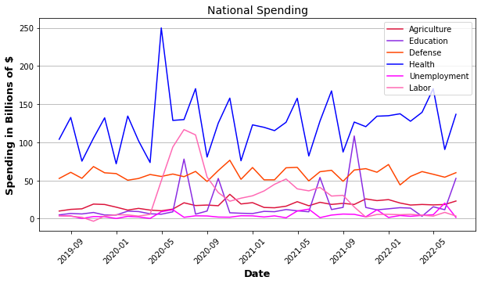
National Spending/National Deficit
Initial Thoughts (Hypothesis): We expect to see large peaks/increases in spending in health, labor, and unemployment departments. We also expect to see agriculture, education, and defense stay relatively constant or decrease in the peak of the pandemic.
Analysis Findings: We saw large peaks and increases in health, labor, and education spending while defense, agriculture, and unemployment spending stayed relatively similar. Education and unemployment yielded interesting results.

Slide 10
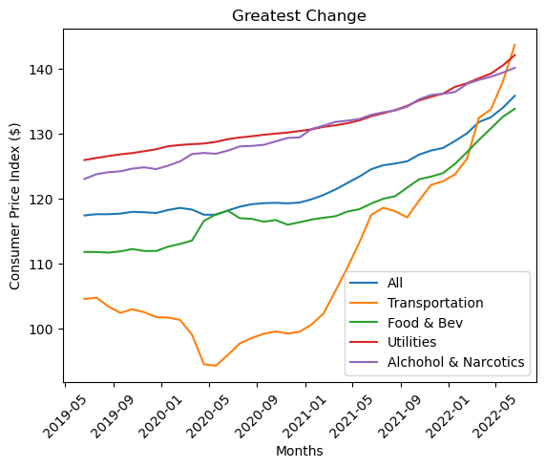
Consumer Price Index (CPI)
Consumer Price Index (CPI) measures the changes in the price of goods and services. CPIs are often used as a metric that reflects a generate rate of inflation. I used percent change of CPIs as a metric for tracking the change in price during and after the COVID-19 lockdown.
Initial Thoughts: Healthcare was going to skyrocket during this time period.
Findings: After reviewing the data, Healthcare didn't experience much fluctuation at all. Instead, it had a steady increase. Moreover, the greatest percent change was Transportation. This makes sense, however, when considering the dramatic change in gas prices, new and used car prices, and changes in Uber/Lyft prices.

Slide 11
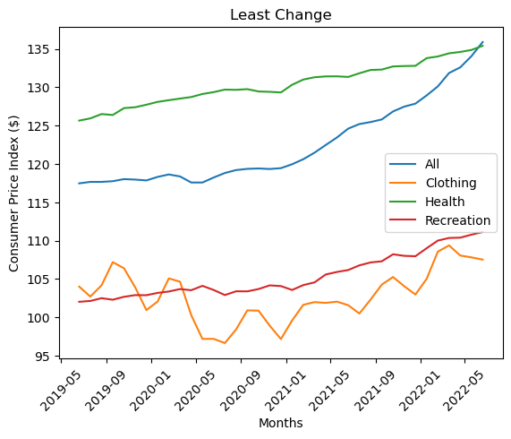
CPI continued…

Slide 12
Questions?

